Slide 1





Amphibious Warfare Training
Major Steele
United States Marine Corps
Chief Warrant Officer 4 Stegman
United States Navy

Slide 2


Agenda
Amphibious Doctrine
Organization of the Amphibious Task Force (Navy)
Amphibious Ships
Organization of the Landing Force (Marine Corps)
Planning - The Marine Corps Planning Process
Planning – Operations Order Format and Content
Planning - The Amphibious Planning Process
Embarkation
Rehearsal
Movement
Action – Advance Force Operations
Action – Beach and Surf Planning
Action – Surface Ship-to-Shore Movement
Action – Logistics Ashore
Action – The Landing Plan
United States Navy / Marine Corps Training Plan

Slide 3
Amphibious Doctrine, History
Major Steele
United States Marine Corps

Slide 4
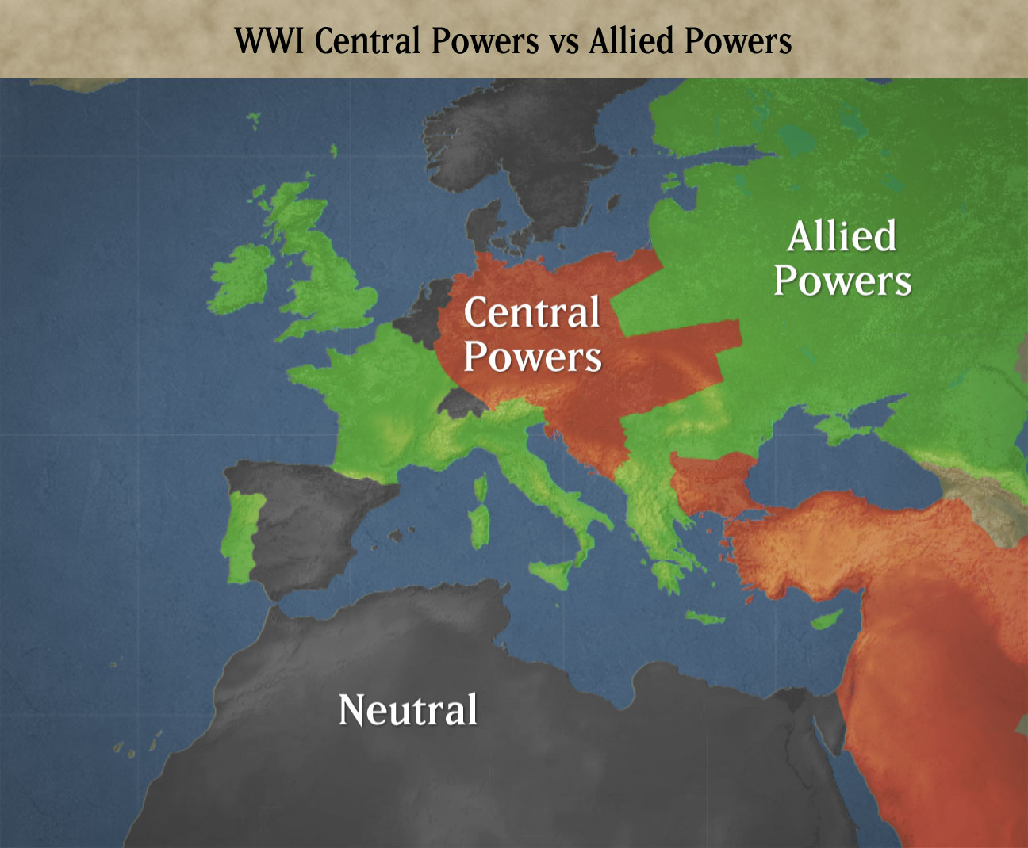
Amphibious History
1915…
Russia was isolated from its allies
Baltic Sea locked by German Navy
Entrance to Black Sea controlled by Ottoman Empire
Western Front, in France and Belgium fixed
Eastern Front essentially the same
Political / Military advantages of new front

Slide 5
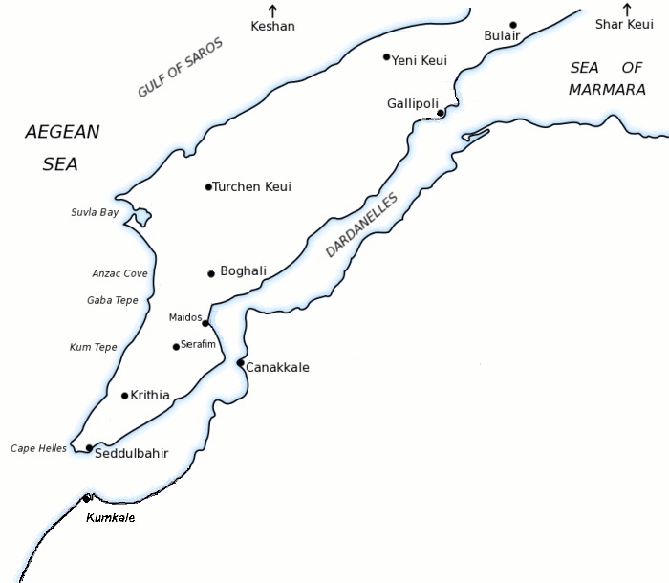
Campaign Overview
Central Powers
Turkish 5th Army
6 Divisions
84,000 Men
Land Mines
Anti-Ship Mines
Sub-Surface Obstacles
Trenches
Short-Range Artillery
Internal Lines of Communication and Resupply
The Allies
First Course of Action:
Navy Only
16 Ships
Mission Failure
Second Course of Action:
Landing Force Employed
xx
7
xx
5
l l
Gendarmerie
l l
Gendarmerie
xx
19
xx
9
First Course
Of Action
Second Course
Of Action
xx
3
xx
11
Notes:
On 18 March, a massive fleet consisting of 16 battleships and now under the command of de Robeck began its attack and was initially successful. A-line attacks first 4 forts and silences their shore batteries. B-line passes lines and continues on next forts.
However, as this line maneuvers to allow mine sweepers to come forward an undetected minefield, laid along the Asian shore, sunk or damaged a number of ships as they turned about.

Slide 6
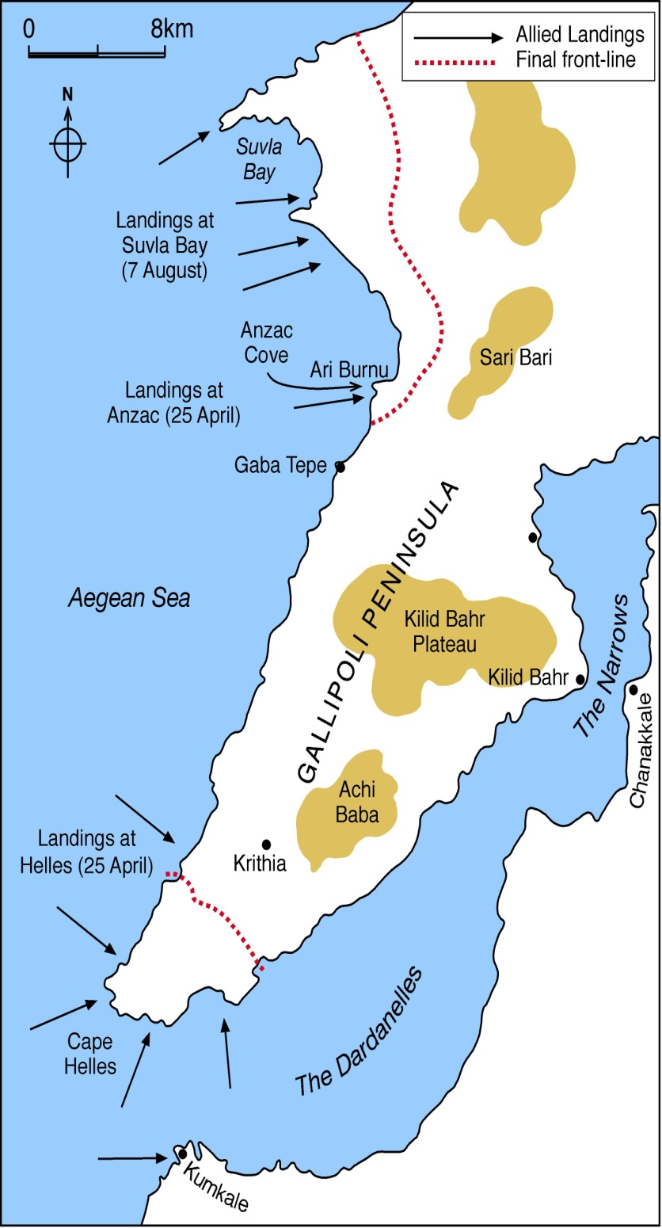
Lessons Learned
V-Beach: Pre-Landing
Turks: Prepared to Oppose Landing with (1) Company
British: Specialized Ship Employed / Fire Support
Employed
V-Beach: H-Hour
Ship runs aground further from shore than expected
Floating bridges used to move soldiers ashore
Bridges drifted twice during the landing
Fire support stopped once landing started
Endstate:
70% of the initial wave of soldiers was killed or wounded.
Remaining soldiers land at night and receive no enemy fire.
Objective Secured
Other Lessons Learned
Y
X
W
V
S
Lessons Learned: Hydrographic and Beach Data Essential / Continuous Fire Support
Notes:
On 18 March, a massive fleet consisting of 16 battleships and now under the command of de Robeck began its attack and was initially successful. A-line attacks first 4 forts and silences their shore batteries. B-line passes lines and continues on next forts.
However, as this line maneuvers to allow mine sweepers to come forward an undetected minefield, laid along the Asian shore, sunk or damaged a number of ships as they turned about.

Slide 7
Amphibious Doctrine, Concepts
Major Steele
United States Marine Corps

Slide 8

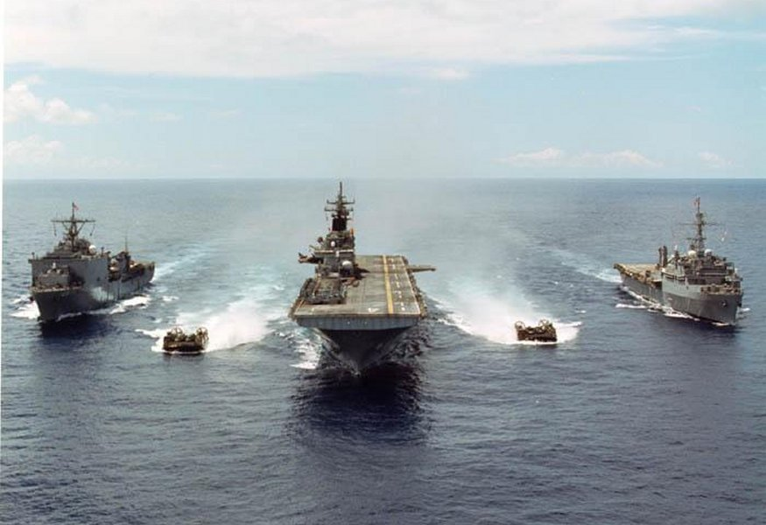
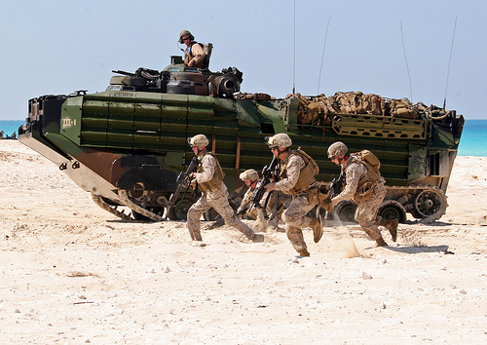
AMPHIBIOUS FORCE
Commander, Amphibious Task Force
Commander, Landing Force
Definition: An Amphibious Task Force and a Landing Force together with other forces that are trained, organized, and equipped for Amphibious Operations.
Navy Force
Landing Force
Notes:
Task Organization formed for the purpose of conducting an Amphibious Operation.

Slide 9
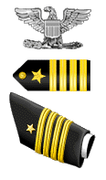
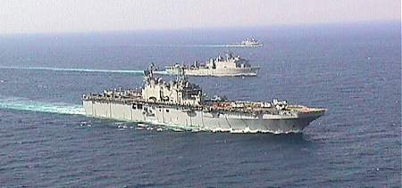
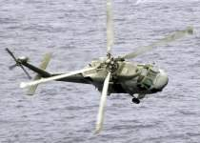
AMPHIBIOUS TASK FORCE
Commander
Amphibious Task Force
Surface Amphibious Ships
Aviation Search and Rescue
Definition: The Navy officer designated in the Initiating Directive as the commander of the Amphibious Task Force
Notes:
Describes all Navy Surface, Air and Submarine units that comprise the AF.

Slide 10
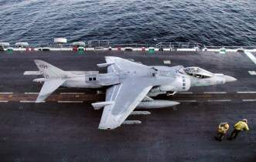
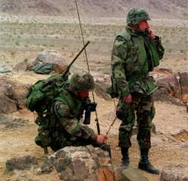
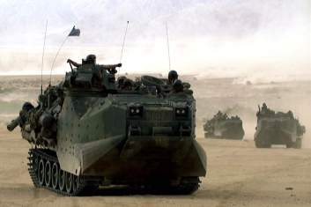
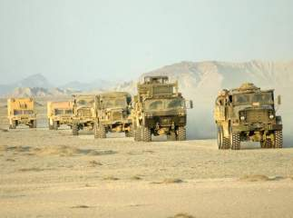
LANDING FORCE
Air Combat Element
Command Element
Ground Combat Element
Commander
Landing Force
Logistics
Combat Element
Definition: The officer designated in the Initiating Directive as the commander of the landing force for an Amphibious Operation.
Notes:
Task Organization of all Ground Troop units, Aviation and Logistics.

Slide 11
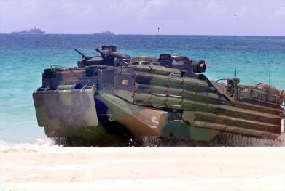
AMPHIBIOUS OPERATIONS
Definition: A military operation launched from the sea by an amphibious force, embarked in ships or craft with the primary purpose of introducing a landing force ashore to accomplish the assigned mission.
Purpose of Amphibious Operations
Types of Amphibious Operations
Keys to Successful Amphibious Operations
Limitations
Relative Strength Requirements
Supporting, Advance Force, and Preassault Operations
Notes:
Task Organization of all Ground Troop units, Aviation and Logistics.

Slide 12
PHASES OF AMPHIBIOUS OPERATIONS
Planning
The period extending from issuance of the order to embarkation.
Embarkation
The embarkation phase is the period during which the forces, with their equipment and supplies, embark in assigned shipping.
Rehearsal
The rehearsal phase is the period during which the perspective operation is rehearsed
Movement
The movement phase is the period during which various elements of the Amphibious Force move from points of embarkation to the Amphibious Objective Area
Action
The decisive action phase
Notes:
Task Organization of all Ground Troop units, Aviation and Logistics.

Slide 13
Organization of the amphibious task force (navy)
Chief Warrant Officer Stegman
United States Navy

Slide 14
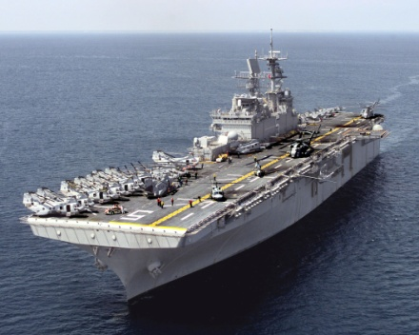
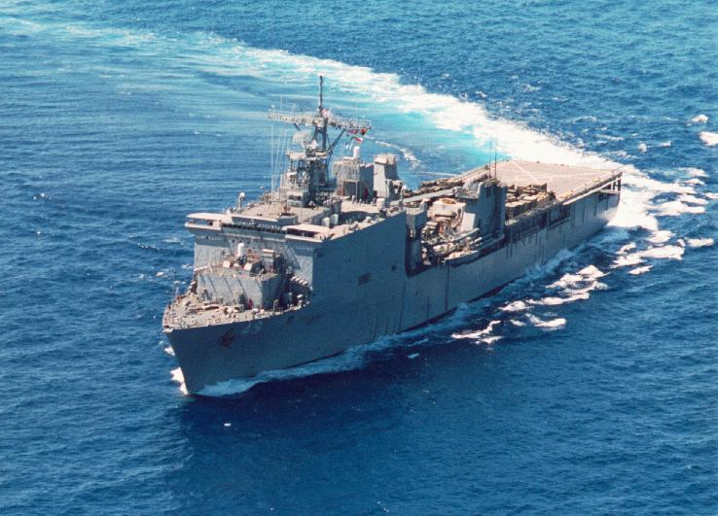
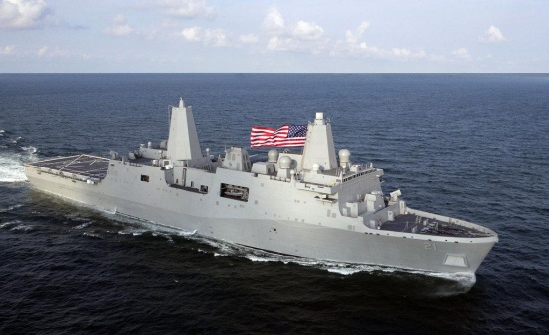
Amphibious Readiness Group
Ships Assigned
Landing, Helicopter Dock (LHD) / Landing, Helicopter Assault (LHA)
Landing Platform, Dock (LPD) / Landing Ship, Dock (LSD)
Deployed with Marine Expeditionary Units to provide continuous forward presence
Notes:
14
LPD 4 (Austin class)
LSD 41 (Whidbey Island class)
LSD 49 (Harper’s Ferry class)

Slide 15
amphibious task force, platforms (navy)
Chief Warrant Officer Stegman
United States Navy

Slide 16
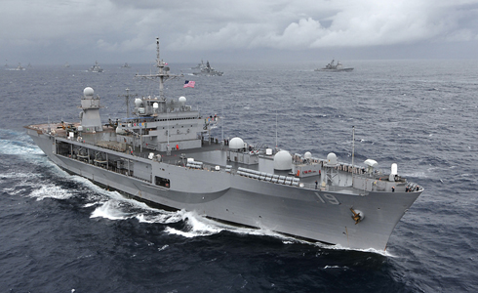
LANDING SHIP, COMMAND AND CONTROL
MISSION: Command ship for a joint task force, commander amphibious task force (CATF), or commander landing force (CLF)

Slide 17
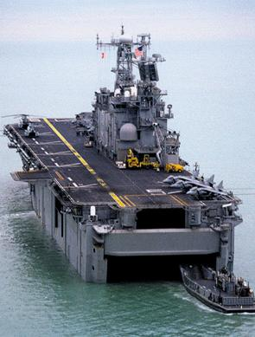
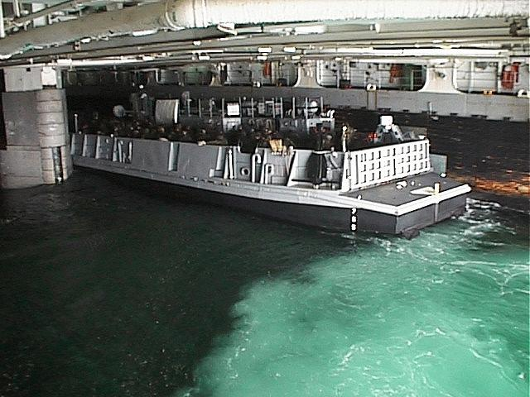
Landing, Helicopter Assault (LHA)
General Purpose Assault Ship
Mission: Embark, deploy, and land elements of a Marine landing force in an amphibious assault by helicopters, landing craft, amphibious vehicles or by a combination of these methods.
Notes:
Prior to getting into the details for planning, let’s first take a look at some basic fundamentals of amphibious operations…Amphib 101

Slide 18
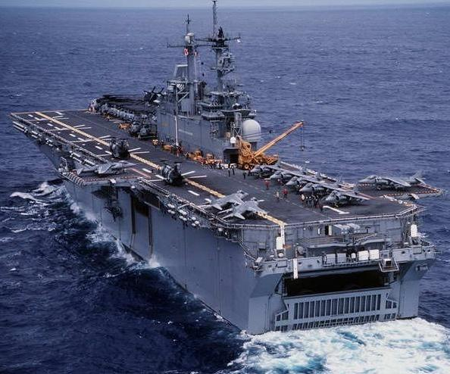
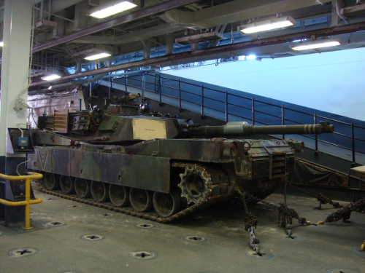
Multipurpose Assault Ship
Landing, Helicopter Dock (LHD)
Mission: The same as LHA with significant improvements in airplane support capabilities, a redesigned well deck that can accommodate three hovercrafts, expanded medical facilities, and upgraded Command and Control capabilities.

Slide 19
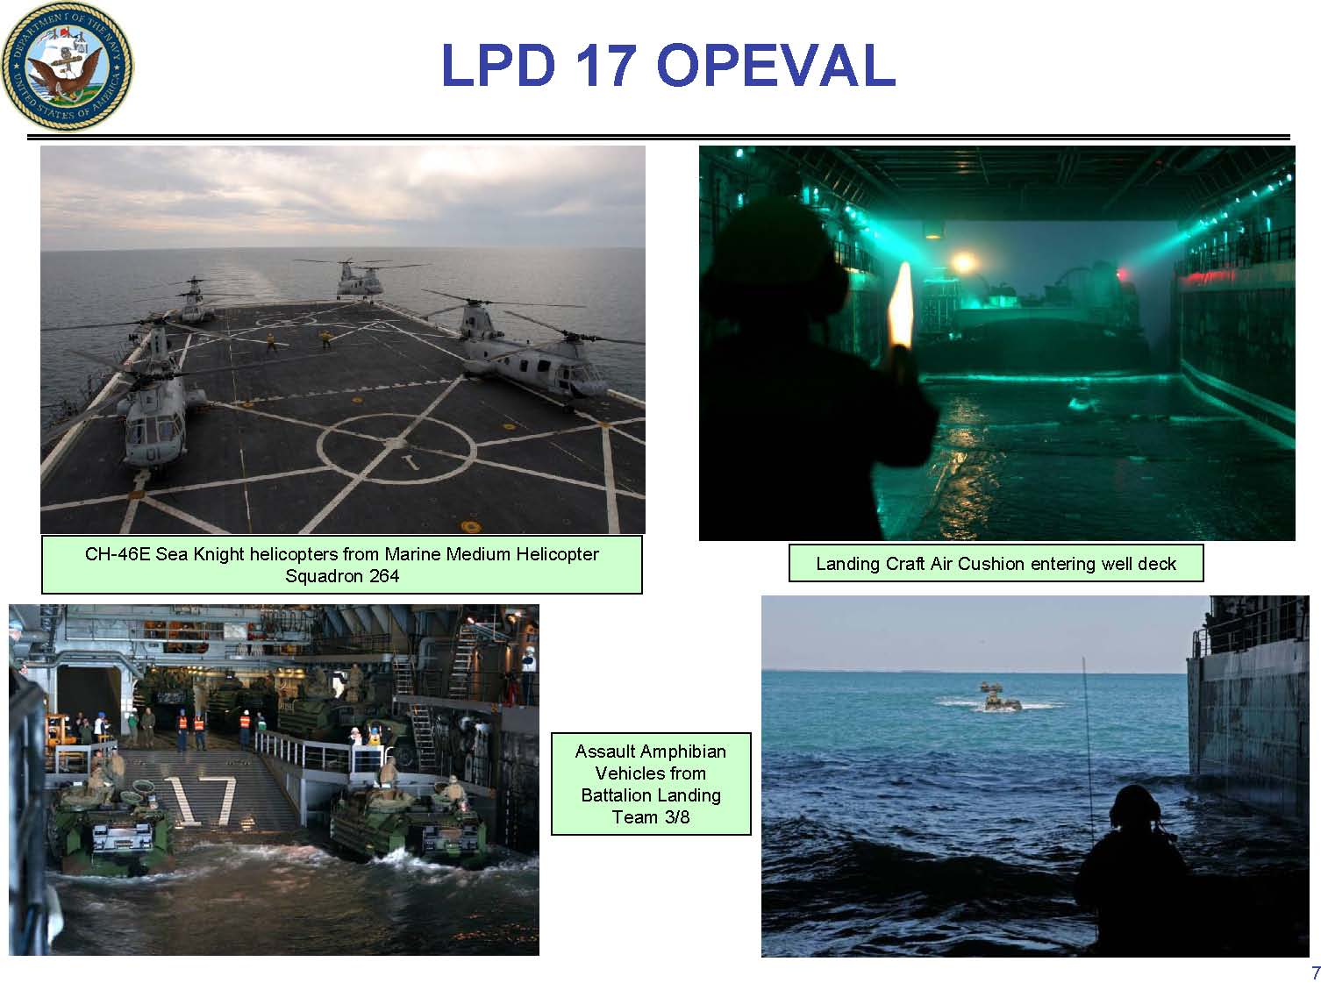
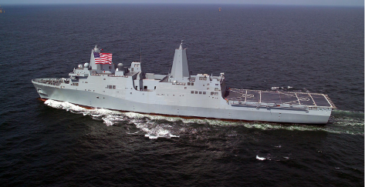
Landing Platform, Dock (LPD)
LPD 17 – Amphibious Transport Dock
Mission: Transport troops and equipment for amphib ops and land them in the assault area by means of helos or landing craft or AAVs carried in the well deck.

Slide 20
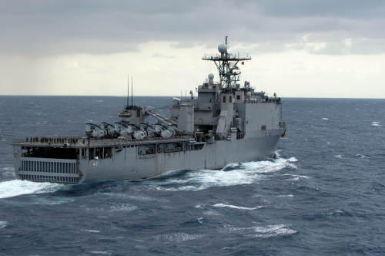
Landing Ship, Dock (LSD)
LSD 41 – Dock Landing Ship
Mission: Transport and launch loaded amphibious craft and vehicles with their crews and embarked personnel. It can render limited docking repair service to small ships and craft.

Slide 21
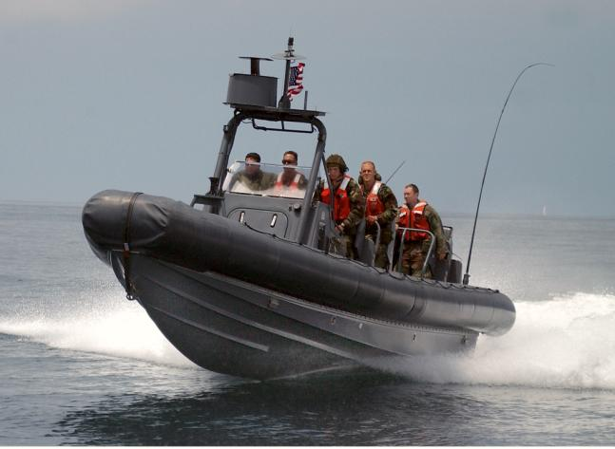
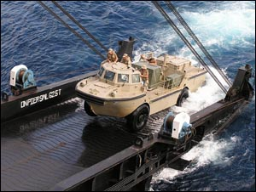
SUPPORT CRAFT
RHIB
Rigid Hull Inflatable Boat
LARC
Lighter Amphibious Resupply Craft

Slide 22
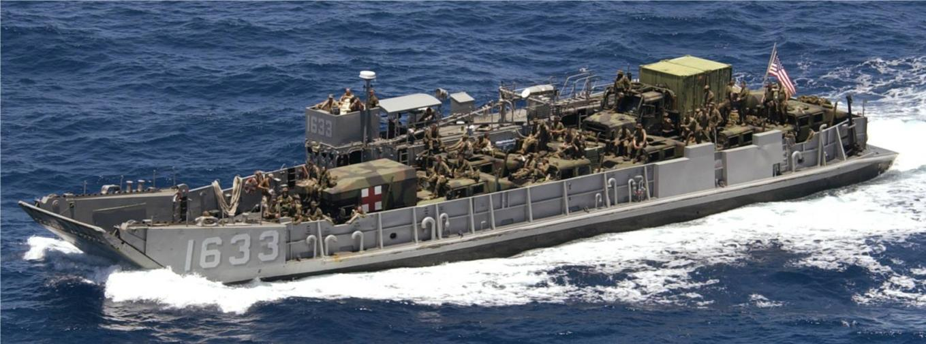
LCU – Landing Craft Utility
MISSION: Transport heavy equipment and supplies from ship to shore

Slide 23
LCAC – Landing Craft Air Cushion
Mission: Transport weapons systems, equipment, cargo and personnel of the assault elements of the Marine Air/Ground Task Force both from ship to shore and across the beach. The landing craft air cushion (LCAC) is a high-speed, over-the-beach fully amphibious landing craft capable of carrying a 60-75 ton payload

Slide 24
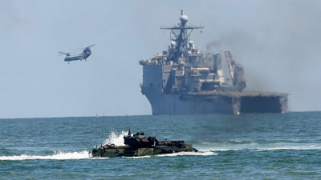
Amphibious Assault Vehicle - AAV
Mission: AAV is used by the assault amphibian (AA) battalion to accomplish its mission to land the surface assault elements of the landing force (LF) and their equipment in a single lift from assault shipping during amphibious operations to inland objectives.

Slide 25
Marine air ground task force organization
Maj Steele
United States Marine Corps

Slide 26
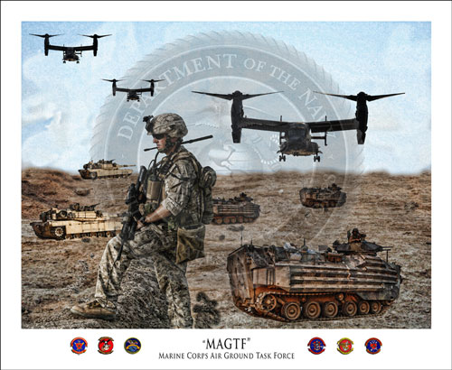
MARINE AIR GROUND TASK FORCE
“MARINE AIR GROUND TASK FORCES ARE BALANCED, COMBINED-ARMS FORCES WITH ORGANIC COMMAND, GROUND, AVIATION AND SUSTAINMENT ELEMENTS
Notes:
I don’t want to insult your intelligence but here is the basic definition for a MAGTF. You need to understand that when you fight a Marine Force there will be more than Marine infantry hitting the beach. We are going to hit you with aviation, artillery, the unit will be supported by its own organic CSS. Additionally, each MAGTF is tasked organized according to the task o the threat. Units that deploy from the west coast might look a little different from units from the east coast. They are all going to vary in size and strength. For the most part you are going to see a ground combat element, Aviation and CSS.

Slide 27
COMPOSITION
ALL MARINE AIR GROUND TASK FORCES ARE COMPOSED OF…
COMMAND
ELEMENT
(CE)
GROUND
COMBAT
ELEMENT
(GCE)
AVIATION
COMBAT
ELEMENT
(ACE)
LOGISTICS COMBAT ELEMENT (LCE)

Slide 28
TYPES OF MARINE AIR GROUND TASK FORCES
MARINE EXPEDITIONARY FORCE (MEF)
~50,000 MARINES
~3,000 SAILORS
MARINE EXPEDITIONARY BRIGADE (MEB)
~18,000 MARINES
~1,000 SAILORS
MARINE EXPEDITIONARY UNIT (MEU)
~2,OOO MARINES
~100 SAILORS
SPECIAL PURPOSE MARINE AIR GROUND TASK FORCE (SPMAGTF)
MISSION DEPENDENT
Notes:
Now lets talk a little about types of MAGTFs. Currently these are the MAGTFs we use. MEFs, MEBs, MEUs and SPMAGTFs. Regardless of what you call these MAGTFs, they consist of 4 basic components.

Slide 29
EMPLOYMENT
Partner & Prevent Crisis Response Contingency Operation Major Combat Operation
Marine Expeditionary Unit
Marine Expeditionary Brigade
Marine Expeditionary Force
Special Purpose Marine
Air Ground Task Force

Slide 30
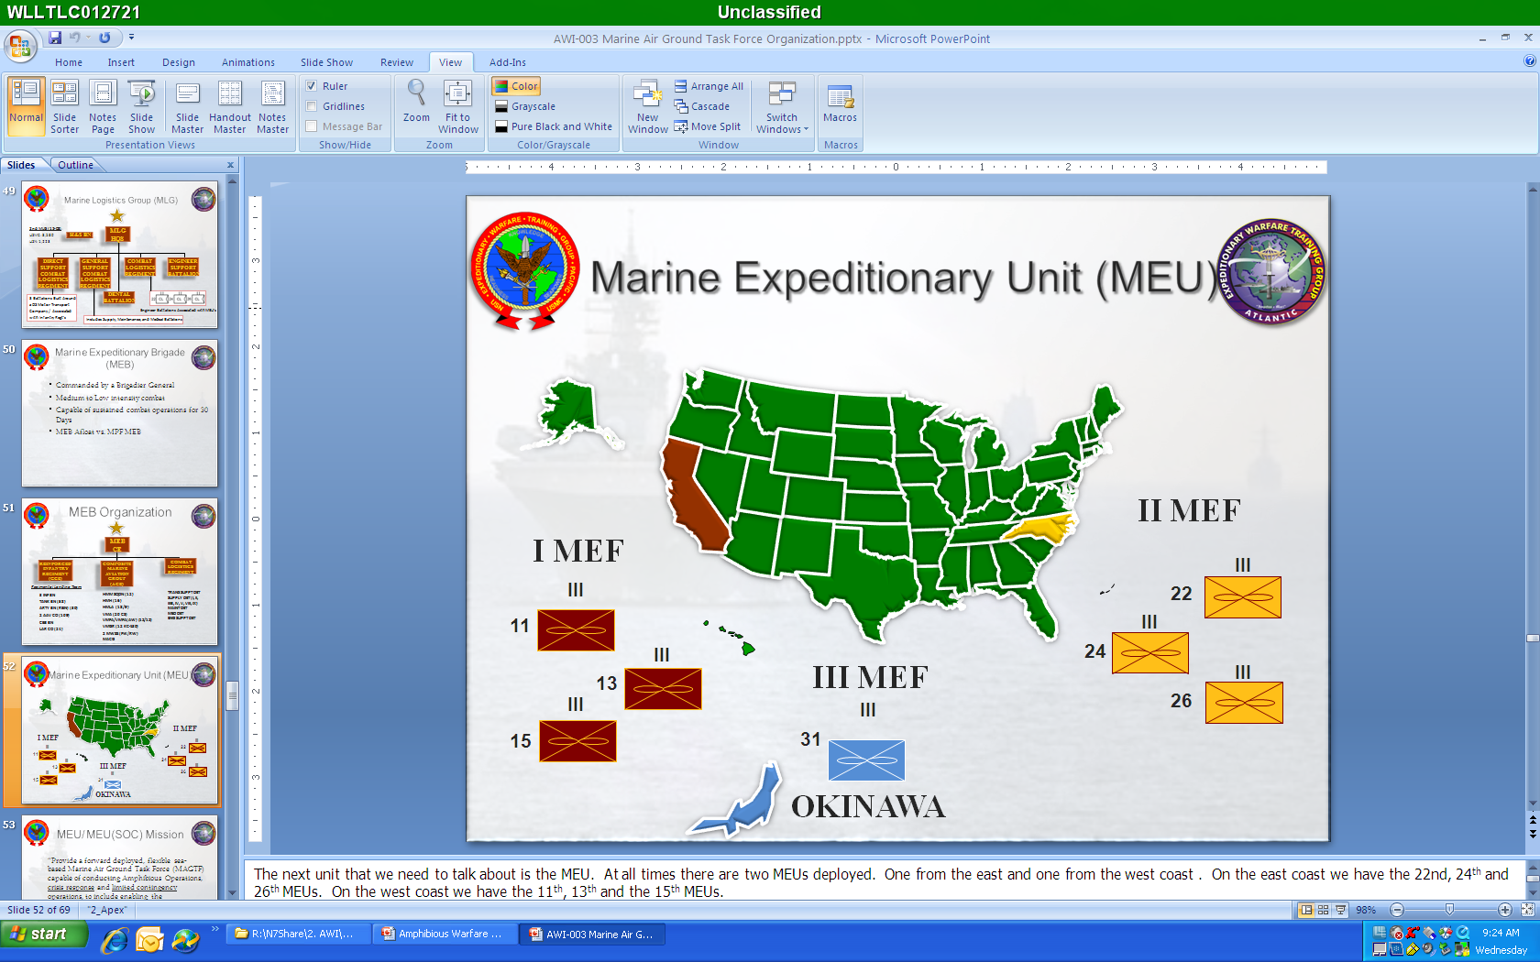
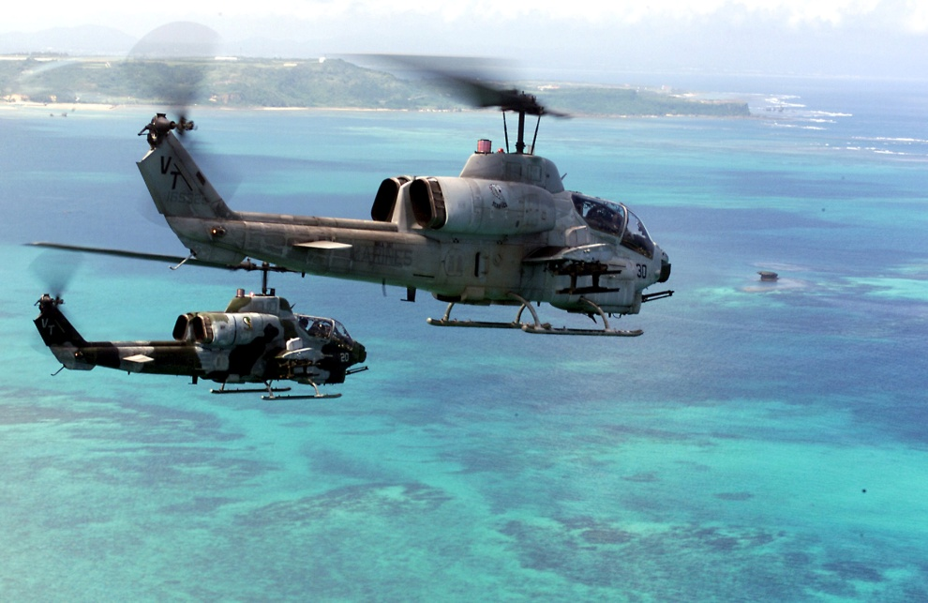
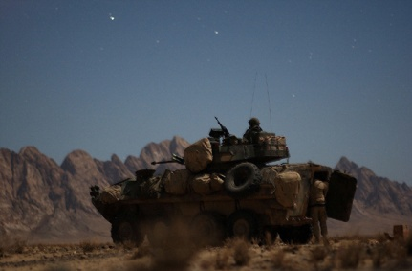
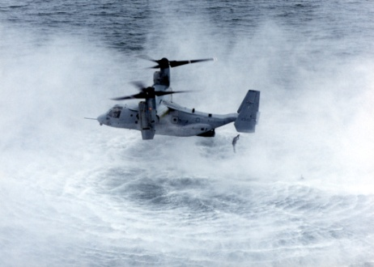
Marine expeditionary unit Organization
Subordinate Units
Battalion Landing Team
Composite Squadron
Combat Logistics Battalion
Missions….
Notes:
Infantry Battalion.
ACE- Composite Squadron 12 46s, 4 ch53s, 4 Cobras, 3 Hueys, 6 AV8 Harriers, and 2 KC130s.
MSSG will still provide the bulk of the support to the MAGTF.

Slide 31
marine corps WARFIGHTING DOCTRINE
Maj Steele
United States Marine Corps

Slide 32
WARFIGHTING DOCTRINE
War Defined: “A violent struggle between two hostile, independent wills, each trying to impose itself on the other…”
This will cause:
Friction
Uncertainty
A Rapidly Changing Environment
Disorder
Significant Impact on the Soldiers and Sailors involved in the conflict (Human Factors)

Slide 33
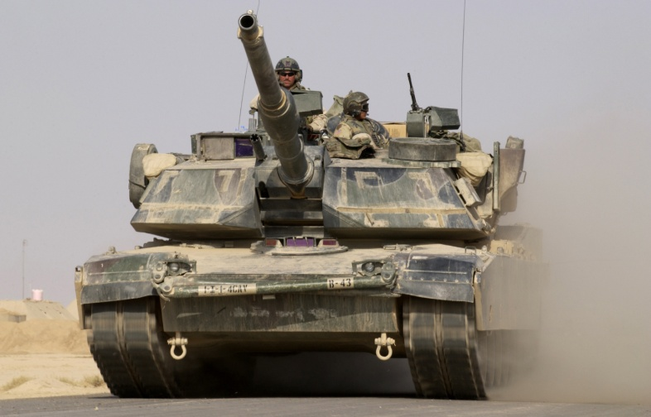
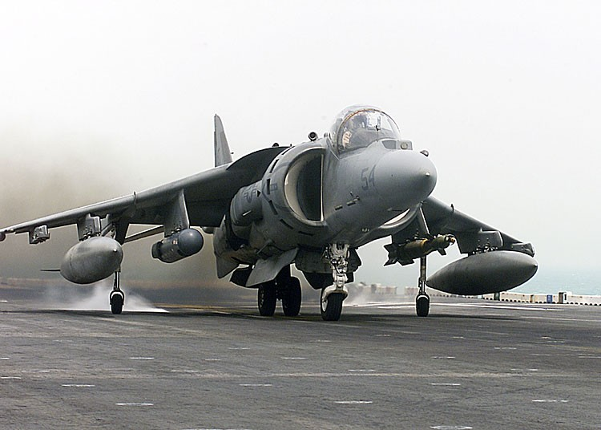
TWO METHODS TO ACHIEVE
VICTORY IN THIS ENVIRONMENT
Attrition Warfare
Victory through cumulative destruction of the enemy assets, usually through superior firepower.
Prefers a statistical advantage over the enemy
Maneuver Warfare
Maneuver warfare is a warfighting philosophy that seeks to shatter the enemy’s cohesion through a variety of rapid, focused, and unexpected actions
Create a turbulent and rapidly deteriorating situation with which the enemy cannot cope.

Slide 34
KEYS TO SUCCESSFUL EXECUTION OF
MANEUVER WARFARE
Focus on the Enemy
Identify Enemy Strengths (Center of Gravity) and Weaknesses (Critical Vulnerability)
Seek to avoid the enemy strength and attack the critical weakness
Give the unit assigned to accomplish the overall mission the support required (Main Effort)
Issue your commanders orders that allow them flexibility on the battlefield (Commander’s Intent)
Use “Combined Arms” to maximum benefit

Slide 35
The marine corps planning process
Maj Steele
United States Marine Corps

Slide 36
PLANNING IN SUPPORT OF
MANEUVER WARFARE
The planning process used in a maneuver warfare environment must…
Focus on the threat
enable both deliberate and recognitional decision-making
Call attention to the need for staff understanding of the “Single Battle Concept”, “Top-Down Planning”, and “Integrated Planning”
Facilitate shared situational awareness
Shape planners thinking with regard to events to occur during the engagement and the outcome
Facilitate the exercise of initiative

Slide 37
FOUNDATION OF THE MARINE CORPS
PLANNING PROCESS
Top-Down Planning
Commander-driven process
The Single Battle
The whole is greater than the sum of its parts
Action anywhere is related to action everywhere
Integrated Planning
Coordinating between Higher / Adjacent / Supporting across Warfighting Functions

Slide 38
MISSION ANALYSIS
Execution
Mission Analysis
Transition
Course of Action Development
Orders Development
Course of Action War Game
Course of Action Comparison & Decision
Notes:
Consider asking audience what the first star indicates (Commander’s Orientation).
____________

Slide 39
MISSION ANALYSIS
Input:
Higher Headquarters
Orders
Intel products
Commander’s Orientation
Battlefield Evaluation
Battlefield
Intent
COG
CCIR
Initial Guidance
Process
Identify Tasks
Assumptions
Constraints / Restraints
Draft Mission Statement
Draft Warning Order
Information Requirements
Output:
Mission statement
Commander’s Intent
Cmdr’s Planning
Guidance
Warning Order
Updated Planning
Products
Staff Estimates
Notes:
The Commander
HHQ order (Commander is getting info from LNOs and from conversations with the higher commander)
The Commander’s Orientation (CBAE and initial guidance)
Battlespace--is AO appropriate for the commander’s areas of interest and influence?
COGs--first cuts at both enemy and friendly COGs
Intent--commander gives the OPT the purpose (the “why”) of the mission
-allows subordinates to frame initiative
-must be clear and concise
CCIRs--what the commander needs to make decisions
The Staff/OPT :
Determine info requirements. also, want to establish info management procedures (RFIs)
Assumptions-must be made to continue planning. Must be recorded and tracked. If not validated, become risks.
Constraints/restraints--what must be done? what cannot be done?
Essential tasks--form basis of mission statement. MUST IDENTIFY SHORTFALLS! Address with HHQ.
Mission statement--approved by commander
Another important part of this process is the standing up of the Red Cell – that group that will portray the enemy force during planning and subsequent wargaming. This cell will normally be made up of individuals with the skills to accurately represent the enemy force.
Outputs
Refined intent (adjustments of method/endstate), plan guidance (left/right limits for planning)
Approved mission statement. Possibly a Warning Order.
At the conclusion of mission analysis, the OPT will have produced a mission statement and various other products that will help them in developing a plan. These products are used throughout planning (Build -- Used Throughout). (Build -- Planning Process).
Once the mission statement and the products are approved by the commander an initial warning order for the major subordinate commands could be issued.

Slide 40
COURSE OF ACTION DEVELOPMENT
Execution
Mission Analysis
Transition
Course of Action Development
Orders Development
Course of Action War Game
Course of Action Comparison & Decision
Notes:
Consider asking audience what the first star indicates (Commander’s Orientation).
____________

Slide 41
COURSE OF ACTION DEVELOPMENT
Input:
Mission Statement
Cmdr’s Intent
Cmdr’s Planning
Guidance
Updated Planning
Products
Staff Estimates
Output:
Designated COAs
for War Game
War Game Guidance
Evaluation Criteria
Estimates of
Supportability
Planning Support
Tools
Process
Analyze Relative Combat Power
Develop Initial COAs
Commander’s Input
COA Refinement
COA Criteria (Staff)
Notes:
Process can be viewed as three step sub-process:
Initial, rough-cut COAs (harness creativity within OPT)
Commander’s input to initial COAs (iterative discussion with Commander to encourage unity-of-purpose)
COA Refinement
Everything bold is also gold. Look for connections between CBAE and War Game Guidance / Evaluation Criteria. This gives you an appreciation of how the Commander’s understanding has evolved along with that of the OPT / working group.
____________
INPUTS
Mission Statement and Commander’s Refined Intent and Guidance from MA help frame COA development (but shouldn’t stifle creativity).
IPB and Staff Estimates are continually refined.
PROCESS Use inputs to steer the OPT during COA Dev
Develop initial (DRAFT) COAs for the commander to review
Commander provides more guidance
COAs refined – developed in detail, two levels below planning HQ (for wargame).
COAs must meet criteria: Feasible, Acceptable, Suitable, Distinguishable, Complete (FAS-DC)
Commander gives guidance as his SA increases - Commander’s drive-by guidance (“Oh, by the way…”) should be recorded.
OUTPUTS
Developed Courses of Action for the Cdr to review
Commander needs to put a lot of thought into his wargaming guidance and eval criteria
IOT focus wargame effort critical for time considerations ( 6-8 hours per COA)
Focus eval criteria on data collection efforts that will support follow-on comparisons and decisions
Examples of criteria include: Speed, risk, force protection, time, flexibility, etc.
STAFF continuously feeds the OPT refined estimates.

Slide 42
COURSE OF ACTION WAR GAME
Execution
Mission Analysis
Transition
Course of Action Development
Orders Development
Course of Action War Game
Course of Action Comparison & Decision
Notes:
Consider asking audience what the first star indicates (Commander’s Orientation).
____________

Slide 43
COURSE OF ACTION WAR GAME
Input:
Designated COAs
for War Game
War Game Guidance
Evaluation Criteria
Estimates of
Supportability
Planning Support
Tools
Output:
War Gamed
COA’s Graphic &
Narrative
Information on Cmdr’s Evaluation Criteria
Branches and
sequels
Process
Organize for Wargame
List all Friendly Forces
Select Method
Conduct COA War Game
Record Results
Refine Estimates
Prepare COA War Game Brief
Refine IPB products
Red Cell
Notes:
____________
INPUTS
COAs identified by the commander; any additional criteria specified for evaluation; any additional guidance provided for the conduct of the war game.
PROCESS
Blue-Red-Blue sequence; this method is used because the intent of the war game is to improve the Blue (friendly) COA
Try to find gaps and seams in the plan
Identifies branches and sequels
Looking to validate assumptions
Scalable: Talk around a sand table or a full day of computer modeling at a JTF HQ.
Refine IPB products and Decision Support Templates based on events that occurred during the war game. Also, ID High Value Targets and High Payoff Targets.
The Commander may refine criteria he used in the war game.
Used for Comparison/Decision step
OUTPUTS
Wargamed COAs for Comparison/Decision and feedback on Commander’s evaluation criteria.
List of critical events and decision points.
Identified branches and sequels.
Continued refinement of staff estimates.
By this point, all COAs will work since they have been validated in the war game and the staff has provided supportability estimates.

Slide 44
COURSE OF ACTION
COMPARISON AND DECISION
Execution
Mission Analysis
Transition
Course of Action Development
Orders Development
Course of Action War Game
Course of Action Comparison & Decision
Notes:
Consider asking audience what the first star indicates (Commander’s Orientation).
____________

Slide 45
COURSE OF ACTION
COMPARISON AND DECISION
Input:
War Gamed COAs Graphic & Narrative
Information on Cmdr’s Evaluation Criteria
Output:
CONOPs
Warning Order
Updated IPB Products
Staff Estimates
Branches
Process
Perform COA Evaluation
Perform COA Comparison
Commander’s Decision
Prepare CONOPs
Refine IPB Products
Notes:
____________
INPUT
Wargamed COA with narrative and graphic
Eval criteria based on Cmdr’s experience, judgment, and assessment of Mission, Enemy, Troops, Terrain.
Criteria could include principles of war or other areas of concern to the commander such as:
Force protection
Risk
Opportunity for maneuver
Speed and Time available/ timing of the operation- just to name a few
PROCESS
COA Eval against criteria and also compared against each other
War Game results provide key input based on this thorough process
Commander makes DECISION
Decision Options available to the Commander include:
Accept COA, as is
Modify COA (requires more wargaming)
Reject all COAs and reconvene the OPT (highly unlikely at this step but possible)
Along with decision, the commander may give refined commander’s intent and CCIRs and Guidance on branches and sequels, prioritized to save time.
OPT will prepare the Concept of Operations (CONOPS) with:
COA graphic and narrative
Refined task organization and synchronization matrix.
OUTPUTS
Approved CONOPS and additional Warning Order to MSCs

Slide 46
ORDERS DEVELOPMENT
Execution
Mission Analysis
Transition
Course of Action Development
Orders Development
Course of Action War Game
Course of Action Comparison & Decision
Notes:
Consider asking audience what the first star indicates (Commander’s Orientation).
____________

Slide 47
ORDERS DEVELOPMENT
Input:
Mission Statement
Refined
Commander’s Intent
Task Organization
Concept of Operation
Tasks
Staff Estimates
Output:
Operations Order
Fragmentary Order
Process
Prepare Operations Order
Orders reconciliation
Orders crosswalk
Commander’s approval
Notes:
____________
INPUT
Everything produced up to this point, to include the MA and Cmdr’s Intent (from STEP 1), Task Organization, CONOPS, Specified and Implied Tasks, etc. IPB continues to be refined.
PROCESS (condensing everything done in planning into plain language)
Operations Order is the most widely distributed document reflecting the planning process
It must be simple and clear
Principal staff sections are responsible for writing the various Annexes and Appendices
Refined staff estimates form the basis for the various sections of the order
Orders Reconciliation– Check for discrepancies. Somebody needs to check what is going into the order
People electronically dump stuff into the order--that’s why they are getting so thick
Basic OPORD for SWA was only 14 pages long
Orders Crosswalk--Check to make sure our order lines up with higher and adjacent orders.
Look for gaps in synchronizing actions on the battlefield.
Commander approves the order with his signature.
OUTPUT
The staff disseminates the signed order.

Slide 48
TRANSITION
Execution
Mission Analysis
Transition
Course of Action Development
Orders Development
Course of Action War Game
Course of Action Comparison & Decision
Notes:
Consider asking audience what the first star indicates (Commander’s Orientation).
____________

Slide 49
TRANSITION
Input:
Operations Order
Fragmentary Order
Refined IPB Products
Planning Spt Tools
Outline Fragmentary
Orders for branches
Output:
Subordinate Cmdrs and staff that are prepared to:
Process
Transition Brief
Drills
Confirmation Brief
Execute the order and possible branches
Plan for sequels
Notes:
(Transition) Transition is the final step of MCPP. But before we close, let’s step back one last time and view MCPP within a broader context.
____________
INPUT
The order (OPLAN, OPORD, FRAGO…)
PROCESS
Transition Brief begins with transition guidance of the commander to include an Overview of mission, commander’s intent, T/O, enemy and friendly situation.
Review of orders and supporting materials
Transition Drill - FOPS handoff to COPS (planners to executors internal to MEF CE)
Review flow of events and rehearse use of planning support tools
Provides thought process behind plan.
May include Execution Drills--(ROC = Rehearsal of Concept)
More specific--Takes “what” of broad plan and discusses the “how” of the plan’s execution.
Confirmation Briefs may be conducted by MSC Commanders to ensure there is common understanding of the plan across the MSC/MSEs.
OUTPUT
Bottom line: we are looking to maintain tempo and carry it into execution! Everyone is prepared and understands how to execute. This includes possible branches and sequels.

Slide 50
Operations orders
Maj Steele
United States Marine Corps

Slide 51
OPERATIONS ORDER FORMAT
(1) Situation
a. General: Overview of the current situation. What brought us to this point.
b. Battlespace: Analyse all aspects of the environment that we will fight in
c. Enemy Forces: The Intelligence Officer goes beyond “known” enemy forces. He determines “most likely” and “most dangerous” enemy courses of action.
d. Friendly Forces: The Operations Officer covers current locations and missions of his unit, as well as adjacent units
e. Attachments and Detachments: Has Higher Headquarters given us any Soldiers for this operation? Have any been taken away?

Slide 52
OPERATIONS ORDER FORMAT
(2) Mission
- The mission statement should answer the following questions: Who, What, When, Where, and Why…
Example:
At 1400, 22 August 2010, 1st Battalion destroys the coastal artillery battery located at GS 124365, in order to prevent that battery from interfering with the landing operations of 2nd Battalion.
A good mission statement is key to successful execution of maneuver warfare….

Slide 53
OPERATIONS ORDER FORMAT
(3) Execution
a. Commander’s Intent:
- Purpose, Method, Endstate
b. Concept of Operations
c. Tasks
- Task for each subordinate unit
d. Identify the Reserve
e. Commander’s Critical Information Requirments
f. Coordinating Instructions:
- These instructions apply to two or more of your subordinate units.

Slide 54
OPERATIONS ORDER FORMAT
(4) Administration and Logistics
(5) Command and Signal
a. Command Relationships
b. Command Posts and Headquarters
c. Succession of Command
d. Signal Plan: What radio frequencies will you be using. Who will be monitoring those frequencies

Slide 55
Planning in an amphibious environment
Maj Steele
United States Marine Corps

Slide 56
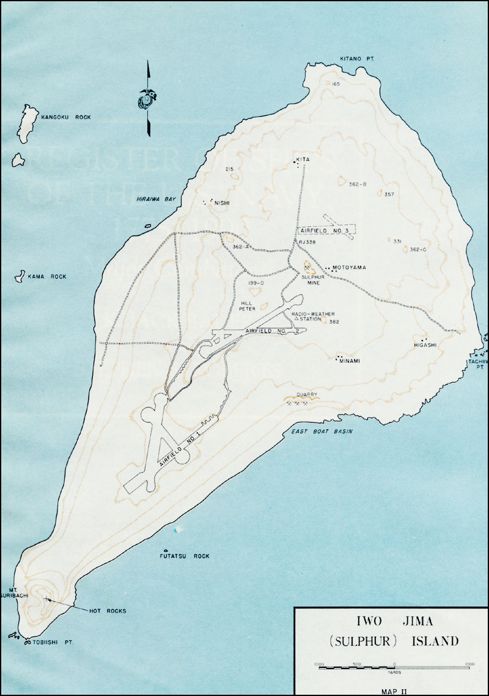
THE 10 PRIMARY DECISIONS
OF AMPHIBIOUS OPERATIONS
PRIMARY DECISION | May be contained in the Higher Headquarters Order | DECISION | Not later than step
Determine AF Mission | X | Mutual | 1
Select AF Objective(s) | X | Mutual | 1
Determine COA for development | X | Mutual | 2
Select COA |  | Mutual | 4
Select Landing Areas |  | Mutual | 4
Select Landing Beaches |  | Mutual | 4
Determine Sea Echelon Plan |  | NAVY | 4
Select Landing Force Objective(s) |  | Marine / Army | 4
Select Landing Zones and Drop Zones |  | Marine / Army | 4
Select Date and Hour of Landing | X | Mutual | 4
Iwo Jima

Slide 57
embarkation
Chief Warrant Officer Stegman
United States Navy

Slide 58
EMBARKATION CONCEPTS
Assault Echelons (AE) and Assault Follow-on Echelons (AFOE) will be embarked in accordance with the embarkation plan
Three fundamentals of embarkation plans:
Mutual Effort – early and continuous communication is ESSENTIAL
Degree of Flexibility – plan for embarkation must support the plan for Ship to Shore movement and ground operations (which are always changing)
Rapid and Effective – the rapid build-up of combat power ashore is crucial

Slide 59
EMBARKATION CONCEPTS
The organization for embarkation consists of temporary task organizations for the Landing Forces and a temporary organization of Navy forces.
Navy Responsibilities…
Landing Force Responsibilities….

Slide 60
EMBARKATION CONCEPTS
Embarkation Officer Responsibilities…
Combat Cargo Officer Responsibilities…
Staff Combat Cargo Officer
Ship Combat Cargo Officer

Slide 61
EMBARKATION CONCEPTS
Keys to successful embarkation planning:
Determination of shipping
Embarkation schedules
Detailed load plans for each ship
Support the tactical plan
Provide for unit self sufficiency
Provide for dispersion of Personnel and Supplies

Slide 62
rehearsal
Maj Steele
United States Marine Corps

Slide 63
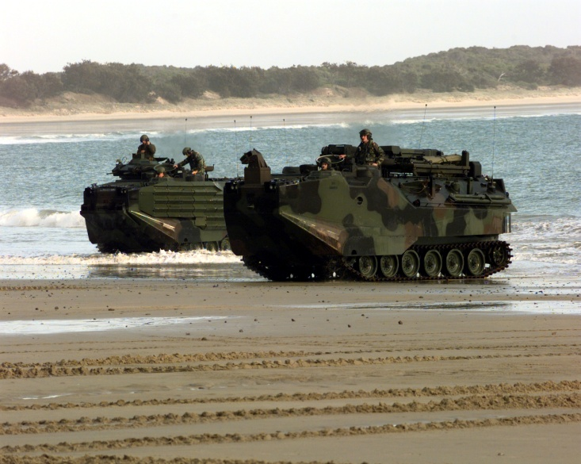
REHEARSAL DEFINED
REHEARSAL- The phase of an amphibious operation in which one or more exercises are conducted by elements of the Amphibious Force (AF) under conditions approximating those to be encountered during the operation.

Slide 64
REHEARSAL CONCEPTS
Must Consider…
NUMBER of rehearsals
NATURE of rehearsals
SCOPE of rehearsals
DATE and TIME of each one
Selection of the rehearsal AREA
Training status of forces
Complexity of Tasks assigned
Intel / Counter-Intel
Amphibious Assault
Force Readiness
Other Requirements
Can Rehearsal Hurt or Help Execution?
Special / unusual problems
Difficult Terrain
Integration of Coalition Partners
Suitability of Rehearsal Area
Time Available
Crisis Action
Is a beach necessary?
Deliberate
Is a beach available?

Slide 65
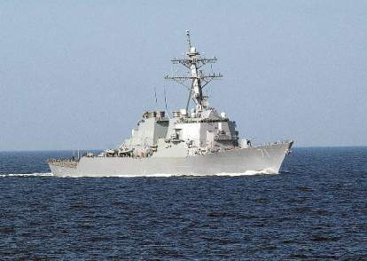
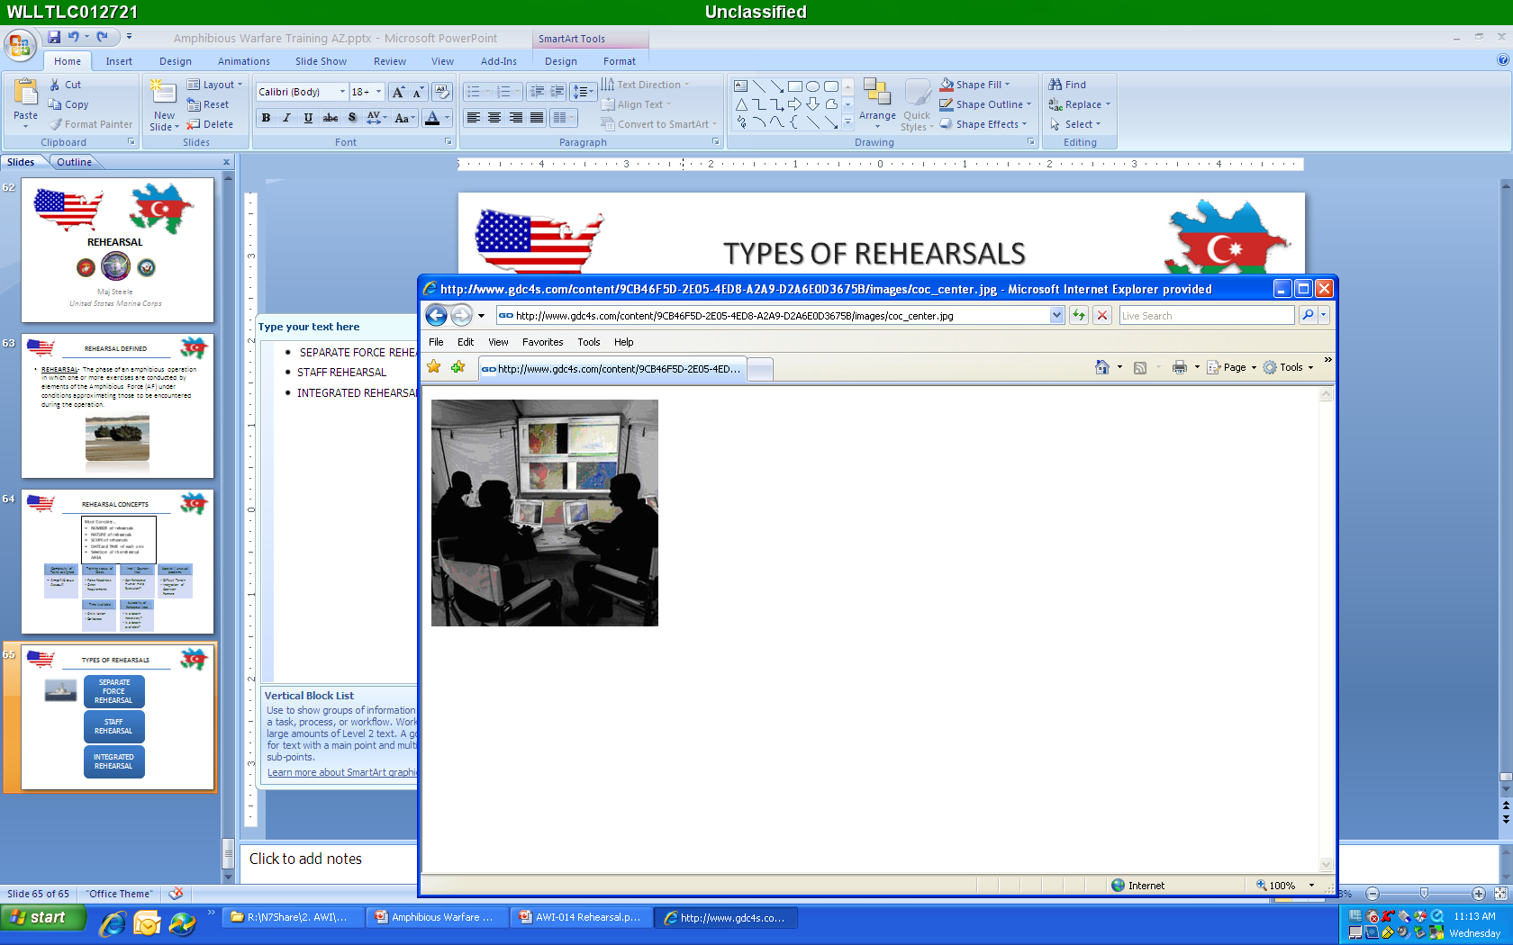
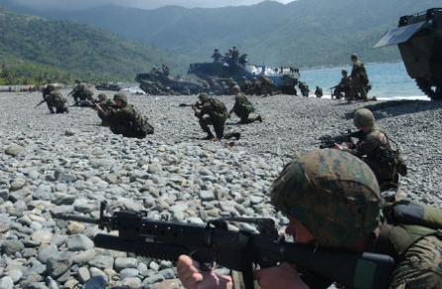
TYPES OF REHEARSALS
SEPARATE FORCE REHEARSAL
STAFF REHEARSAL
INTEGRATED REHEARSAL

Slide 66
MOVEMENT
Chief Warrant Officer Stegman
United States Navy

Slide 67
ORGANIZATION FOR MOVEMENT
Amphibious shipping will be divided in support of the landing plan into multiple kinds of groups
Transport Groups
Movement Groups
Pre-D-day Groups
Post-D-day Groups
Follow-up Groups

Slide 68

ORGANIZATION OF THE SEA AREA
Amphibious Assault Vehicle Launch Area
INNER
TRANSPORT
AREA
Boat Lanes
Hovercraft Launch Area
OUTER
TRANSPORT
AREA
Hovercraft Launch Area
SEA ECHELON AREA
CLOSE SUPPORT AREA
DISTANT RETIREMENT AREA

Slide 69
Action: supporting, advance force, and preassault operations
Maj Steele
United States Marine Corps

Slide 70
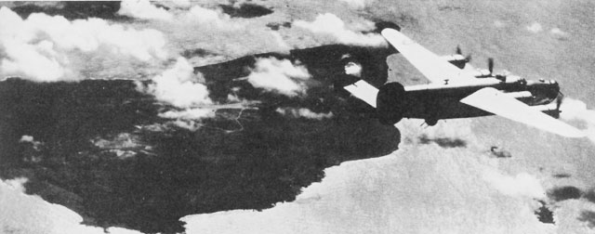
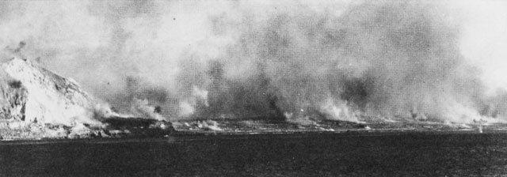
SUPPORTING, ADVANCE FORCE, AND
PREASSAULT OPERATIONS
Plans and Actions are Driven by the Desire to Shape the Battlespace
Shaping Actions Traditionally Occur Sequentially
The Order of Occurrence:
Supporting
Advanced Force
Preassault
The force used and time of execution
typically define the operation
The Basic Purposes:
Isolate the landing area
Gain Information on the enemy and Environment
Prepare the landing area for the insertion of the LF
Iwo Jima: Bombing began 74 days before landing
Iwo Jima: Battleships fire for days before landing

Slide 71
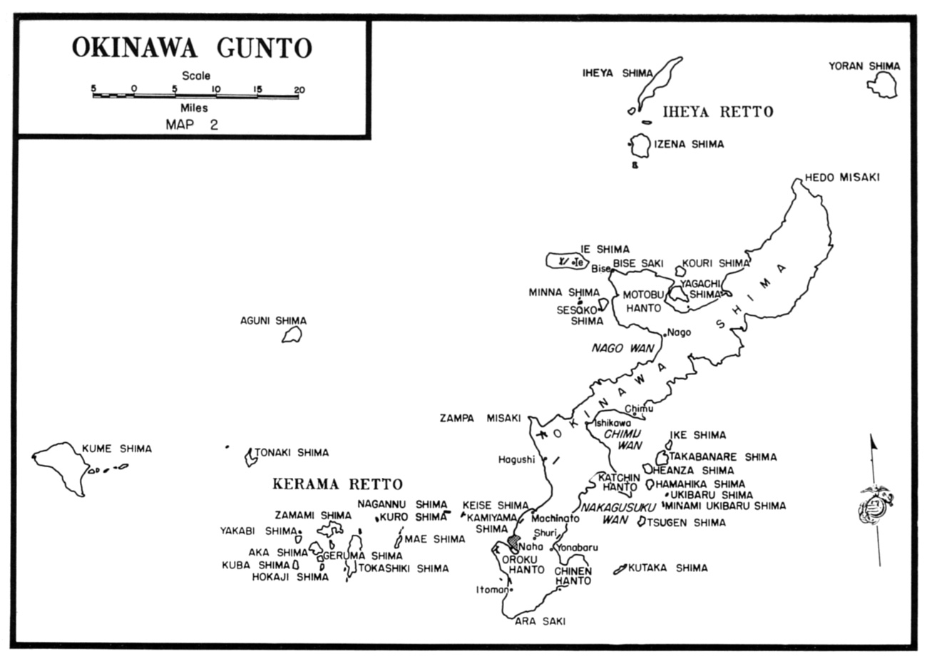
SUPPORTING, ADVANCE FORCE, AND
PREASSAULT OPERATIONS
Isolation of the Landing Area
Prevent the enemy from maneuvering within, reinforcing, or supplying forces that oppose the assault
Gain Information
HUMINT
Aviation ISR Platforms
SIGINT
Prepare the Landing Area
Aviation / NSFS Targeting
Seizure of Key Terrain
Destruction / Neutralization
of Targets (Raids)
Reduction of Mines and
Obstacles
Clear Seaward approaches
Set conditions for effective guidance of landing craft

Slide 72
SUPPORTING, ADVANCE FORCE, AND
PREASSAULT OPERATIONS
Considerations for Planning Preassault Operations
Clandestine Preassault
Advantage: Potential to achieve surprise / Intel
Disadvantage Isolation? Preparation of Landing Area
Overt Preassault
Advantage: Isolation / Landing Area Prepared / Intel
Disadvantage: Reserve Triggered
Deception
Advantage: Enemy reduced / disrupted
Disadvantage: Reduced Combat Power Available

Slide 73
BEACH AND SURF PLANNING
Chief Warrant Officer Stegman
United States Marine Corps

Slide 74
WAVE TERMS
WAVELENGTH
WAVE HEIGHT
CREST
UNDISTURBED LEVEL
TROUGH

Slide 75


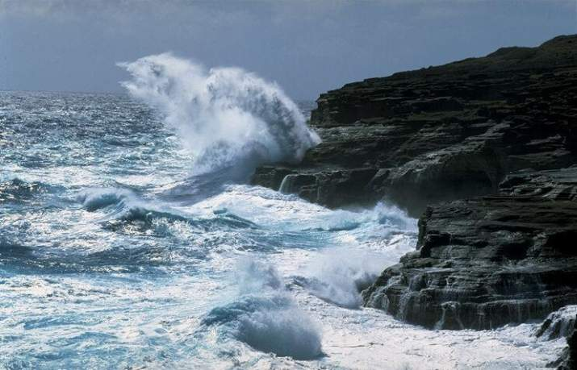
BREAKER TERMS
Spilling
Plunging
Surging

Slide 76
BEACH TERMS
Steep 1:15 or steeper
Moderate 1:15 to 1:30
Gentle 1:30 to 1:60
Mild 1:60 to 1:120
Flat 1:120 or flatter
Preferred

Slide 77
LONG SHORE CURRENT
Found in the surf zone
Flow parallel to the shore line inside the breakers
Most commonly found on straight beaches
CURRENT

Slide 78
RIP CURRENT
OUTGOING WAVES
INCOMING WAVES
INCOMING WAVES
Caused by the waves piling water against the coast
Flows along shore until it is reflected seaward by bottom irregularities or until it
meets another current and flows out through the breakers
78

Slide 79
BEACH SELECTION
INFORMATION REQUIRMENTS
Surf/swell
Tides
Currents
Water depth
Beach slope
Beach features
Sea state
Surf zone width
Sig. breaker height
Depth/angle breaking
Wavelength
Longshore current
Breaker Period
Enemy Situation

Slide 80
Surface ship-to-shore movement
Chief Warrant Officer Stegman
United States Navy

Slide 81

SURFACE SHIP TO SHORE
MOVEMENT

Slide 82
Logistics on shore
Chief Warrant Officer Stegman
United States Navy

Slide 83
LOGISTICAL PLANNING FACTORS
Operation characteristics
Target date
Objective Area characteristics
Enemy capabilities
Size, type of LF
Means of distribution
Transportation infrastructure
Resupply
Phased increase in logistics capabilities
Enemy Prisoners of War
Availability of logistic means
Compatibility, capability of support systems
Communication
Force Protection
Airfields
Chemical Threat
Shipping availability
Health risks

Slide 84
THE LANDING FORCE SUPPORT PARTY
Temporary Landing Force organization, composed of Navy and Landing Force elements, that facilitates the ship-to-shore movement and provides initial combat support and combat service support to the Landing Force.
Landing Force Support Party
Organization
HEADQUARTERS
SHORE PARTY
BEACH PARTY
HELICOPTER SUPPORT
SPECIAL ATTACHMENTS

Slide 85
The landing plan
Maj Steele
United States Marine Corps

Slide 86
LANDING PLAN DOCUMENTS
The Serial Assignment Table:
Definition: The LF serial assignment table lists in numerical order the serial numbers of all units that are landed prior to general unloading. The table is a ready reference for the composition of each unit assigned a serial number….
What is a Serial?
Definition: A group of LF units and their equipment which originate from the same ship and that, for tactical or logistics reasons, will land on a specified beach or a specified HLZ at the same time.
Example: 1520 = 1st Squad, 1st Platoon, India Company
The Battalion creates an “Equipment Density List” that is tied to the Serial Assignment Table

Slide 87
LANDING PLAN DOCUMENTS
The Landing Diagram:
Definition: A graphic depiction of the tactical deployment of boat teams in scheduled waves
Scheduled Waves | Wave Composition | Serial
Wave # Time | Unit Description Craft Type Boat Team # | Ref LCAVAT/ SAT
 |  | 1345 1350 1355 1440
Wave 1
H-Hour
Co C (-)(Rein); 1st Asslt Amphib Plat (-)(Rein)
X X X (X)* X X X X
1-1 1-2 1-3 1-4 1-5 1-6 1-7 1-8

Slide 88
LANDING PLAN DOCUMENTS
Landing Craft and Assault Vehicle Landing Table:
Definition: A table showing the assignment of personnel and materiel to each landing craft and amphibious vehicle and the assignment of the landing craft and amphibious vehicles to waves for the ship-to-shore movement.
Craft No
Personnel and Material
Boat Spaces
Formation
Two-digit
Description of unit, person or
or item filling a boat space
Number of spaces
filled by person, unit
or item
From landing
diagram
Type
1-1
1st Sqd, 1st Plt, Co B
11
AAVP7
Corpsman
1
MG Tm, 1st MG Sqd
3
SMAW Tm, 1st Assault Sqd
2
17

Slide 89
LANDING PLAN DOCUMENTS
The Landing Sequence Table:
Definition: The LST is a complete listing of the estimated landing sequence of nonscheduled units … It is the principle document used by control agencies in directing the ship-to-shore movement of these units. (MCWP 3-31.5)
LANDING SEQUENCE TABLE
Unit | Element | Serial # | Carrier No. Type |  | Ship | Beach | Remarks
WPNS
CO
AT SECT,
AA PLT
3205
1 LCAC
LPD-
17
BLK
BCH 1
WPNS HMG PLT 3200 1 LCAC LPD- BLK
CO 17 BCH 1

Slide 90
Navy and marine deployment training
Maj Steele
United States Marine Corps

Slide 91
NAVY AND MARINE
DEPLOYMENT TRAINING
Navy Major Training Events
Fleet Synthetic
Training
Ship Training & Maintenance
Warfare
Commanders
Conference
At Sea
Maintenance
Staff Planning
Workshop
At Sea
At Sea
At Sea
Marine Major Training Events
At Sea
At Sea
Staff Planning
Workshop
Warfare
Commanders
Conference
Urban
Training
At Sea
At Sea
Maintenance
Unit Driven: Individual / Collective Training
Fleet Synthetic
Training
270
240
210
180
150
120
90
60
30
0

Slide 92
Amphibious Warfare Training
Major Steele
United States Marine Corps
Chief Warrant Officer 4 Stegman
United States Navy

